Slide 1
Dissertation papers
How globalization shapes today’s political & security environments (a.k.a. the mess)
1945-1970: embedded liberalism
1971-1990: neoliberalism (after Nixon shock)
1991-now: hyper-globalization (after Cold War)
Paper 1: globalization ➔ a theory of engaged reformer ➔ autocratic rise
Paper 2: free trade theory neglects “what happens after trade equilibrium” ➔ advantage sectors threatened ➔ trade is non-starter & globalization backlash
Paper 3: globalization creates a lot of issues ➔ a theory of issues -- how issues harms the liberal international order and affect great power politics

Slide 2
The Globalization Origins of Autocratic Rise
Engaged Reformers, Autocratic Advantages, and the Post-Cold War Reversal
George Yean
PhD Candidate, Harvard University
APSA, 2025

Slide 3
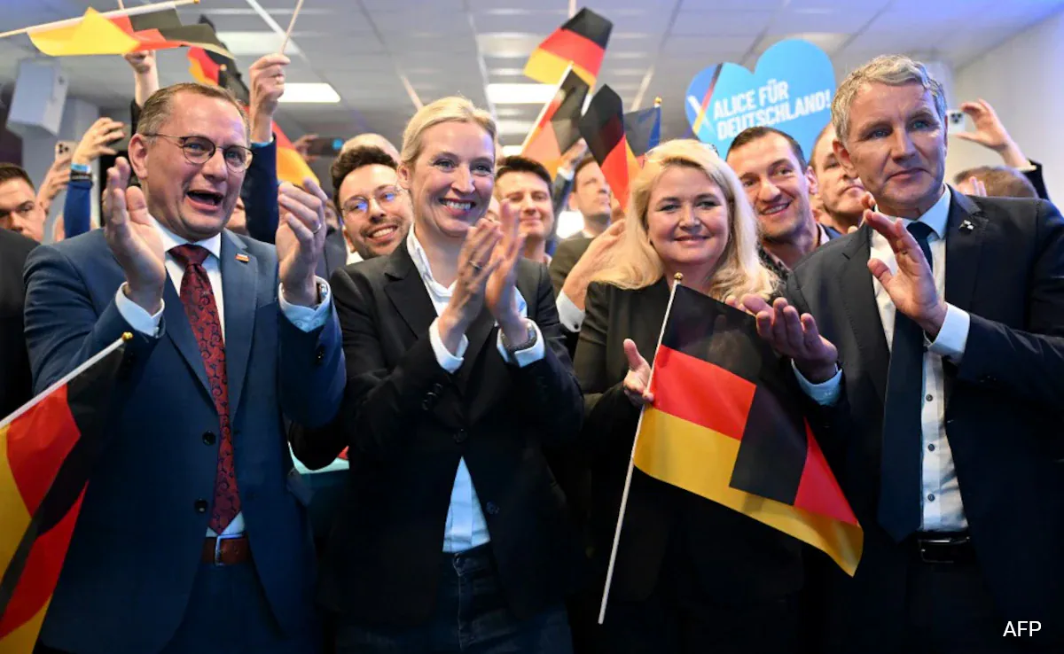
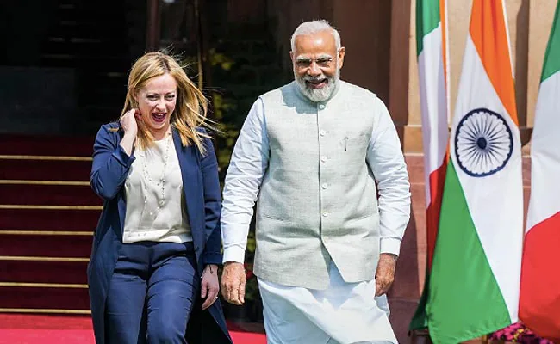
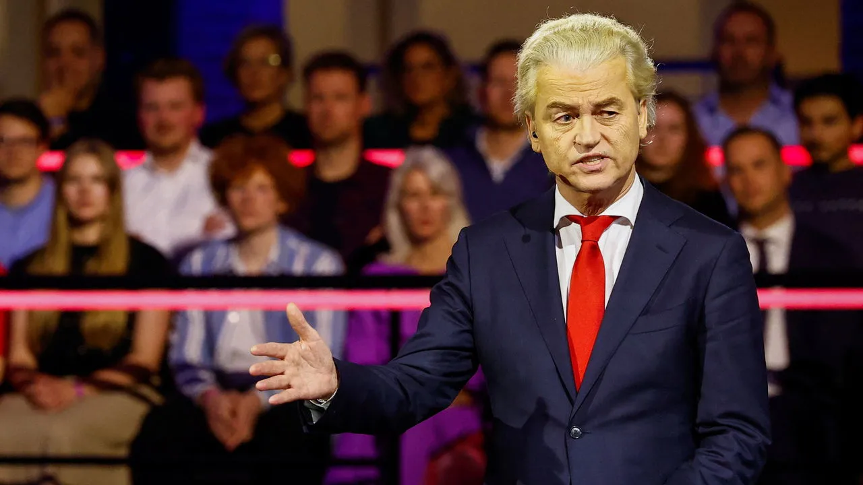
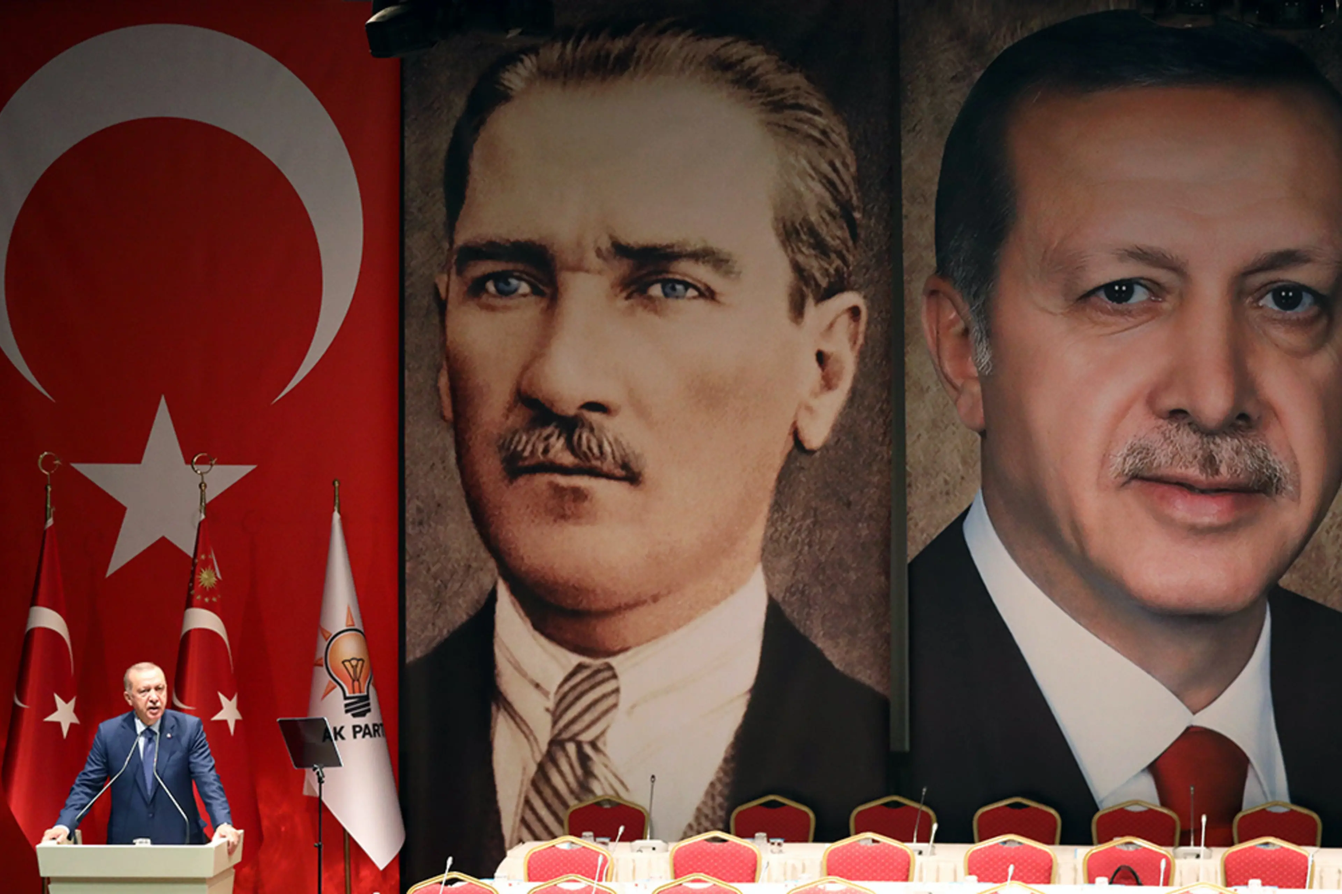
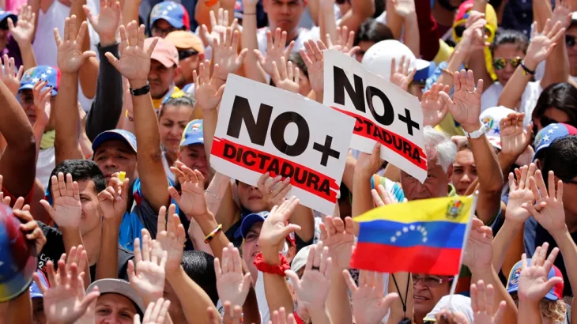

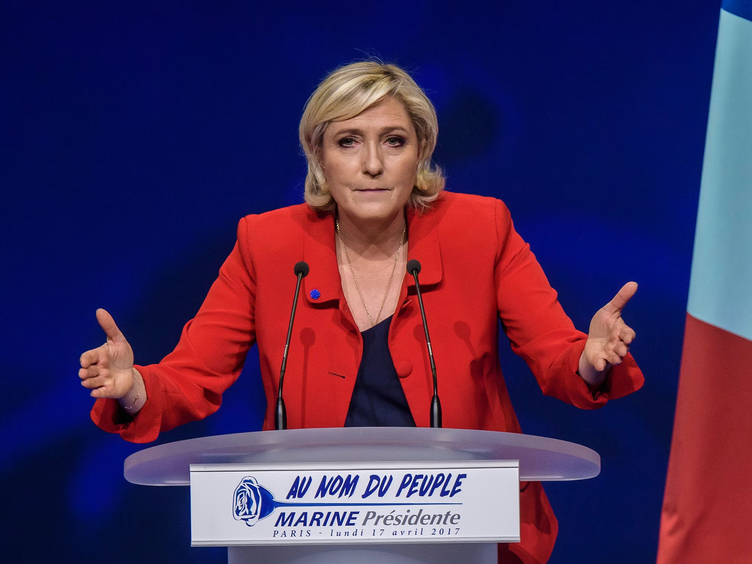
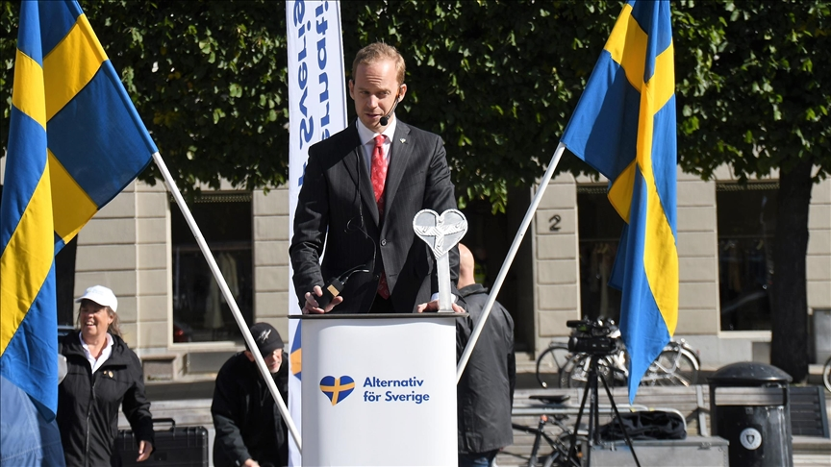

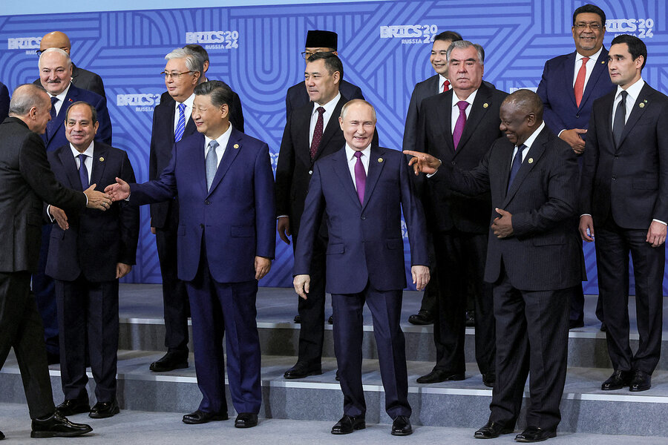
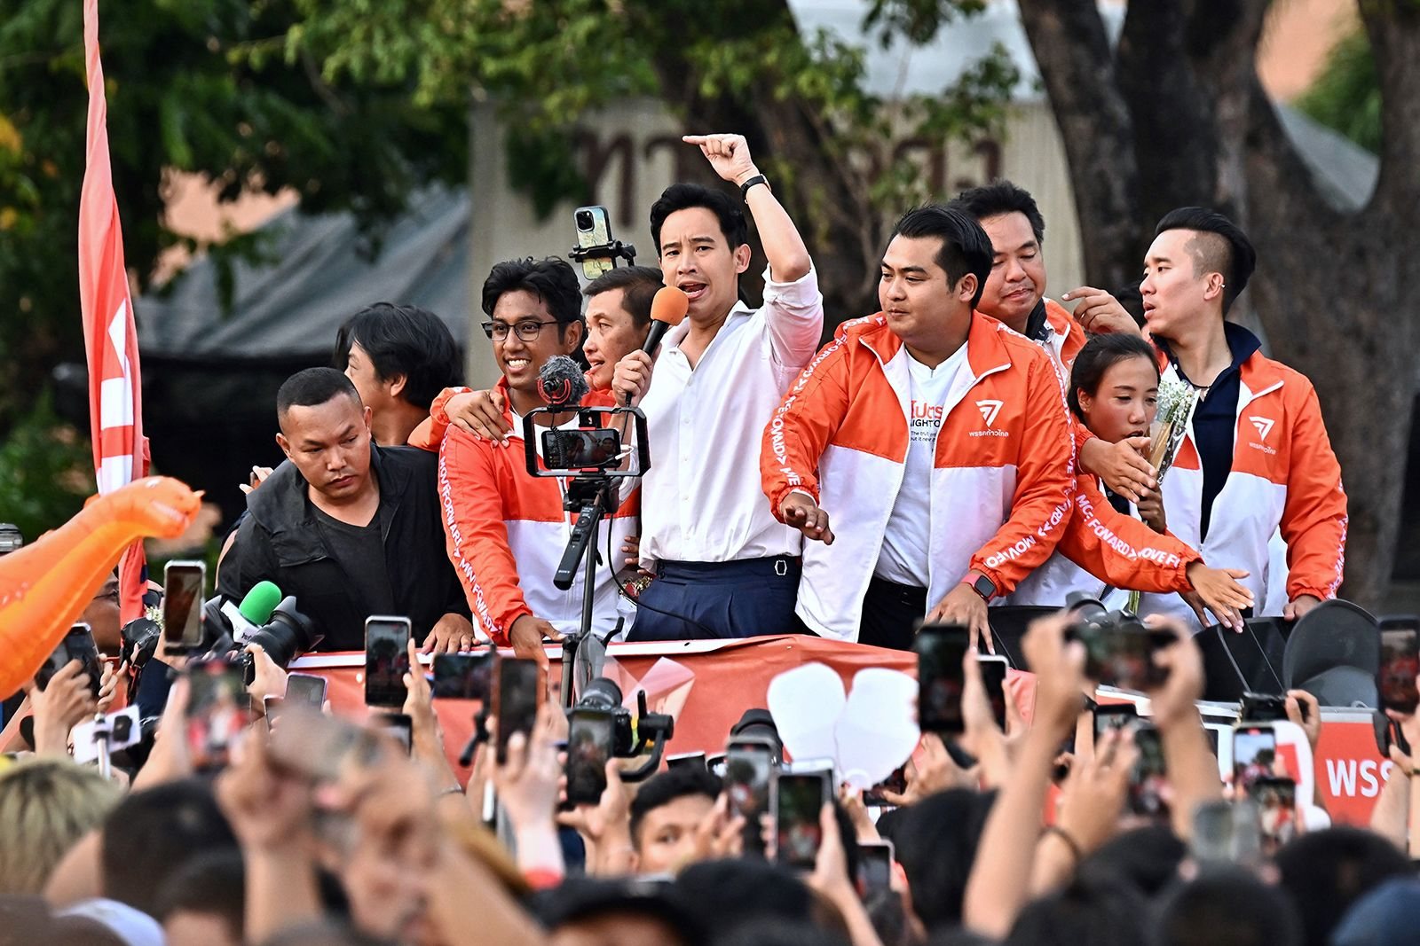
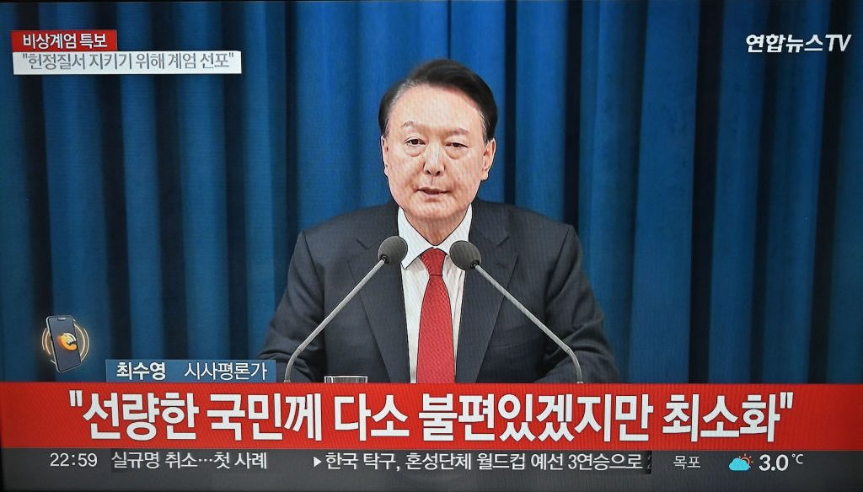
Democratic Backsliding
/ Crisis
Notes:
“trade and economic endeavour should be conducted with a view to raising standards of living, ensuring full employment and a large and steadily growing volume of real income and effective demand, developing the full use of the resources of the world and expanding the production and exchange of goods.” Institutional development frequently depends on prior outcomes ("path dependence") and evolutionary forces. As institutions evolve, rational design choices can arise in two ways. First, participants may modify institutions in stages, by making purposeful decisions as new circumstances arise, by imitating features from other institutions that work well in similar settings, or by designing explicit institutions to strengthen tacit cooperation. Second, institutions may evolve as states (and other international actors) select among them over time. States favor some institutions because they are better suited to new conditions or new problems and abandon or downplay those that are not. For example, the obvious place to handle intellectual property rights would seem to be the World Intellectual Property Organization, but the countries that generate most patents chose to move the issue to the WTO because it offered better enforcement mechanisms. Thus the institutionalization of the issue evolved significantly, not because an older institution was modified, but because another one offered a better institutional design.

Slide 4
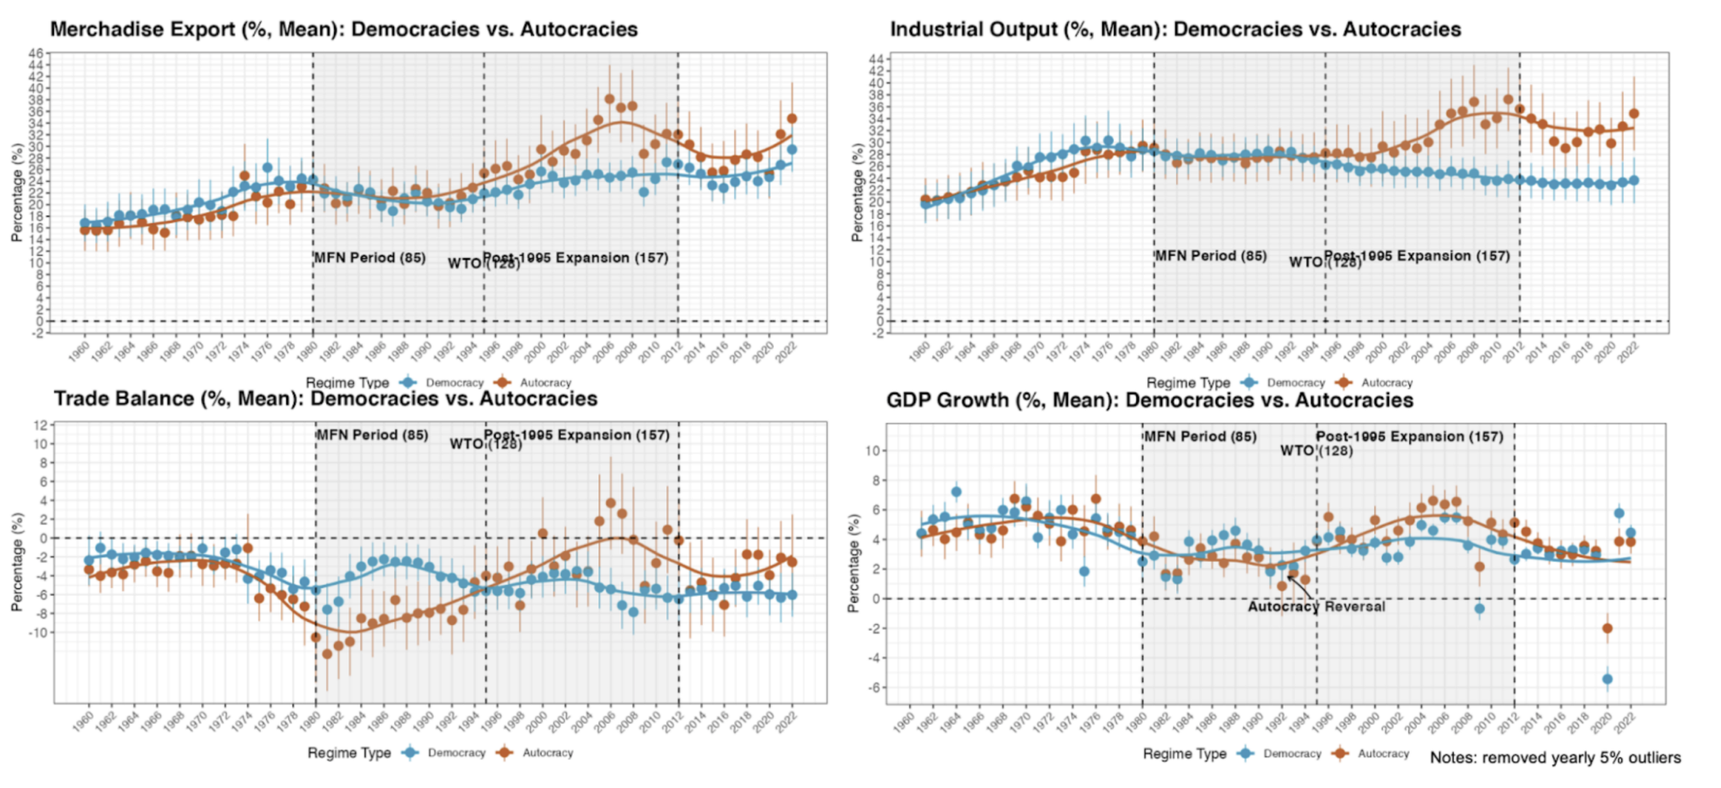
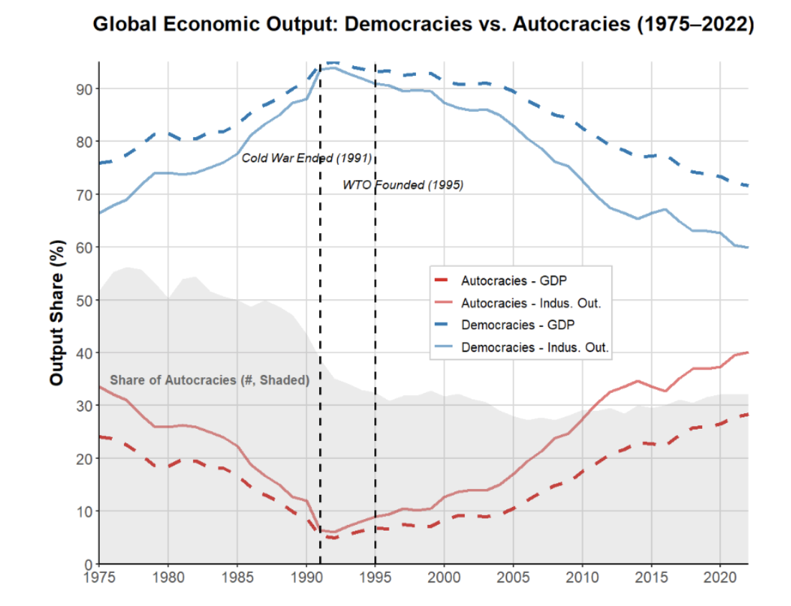
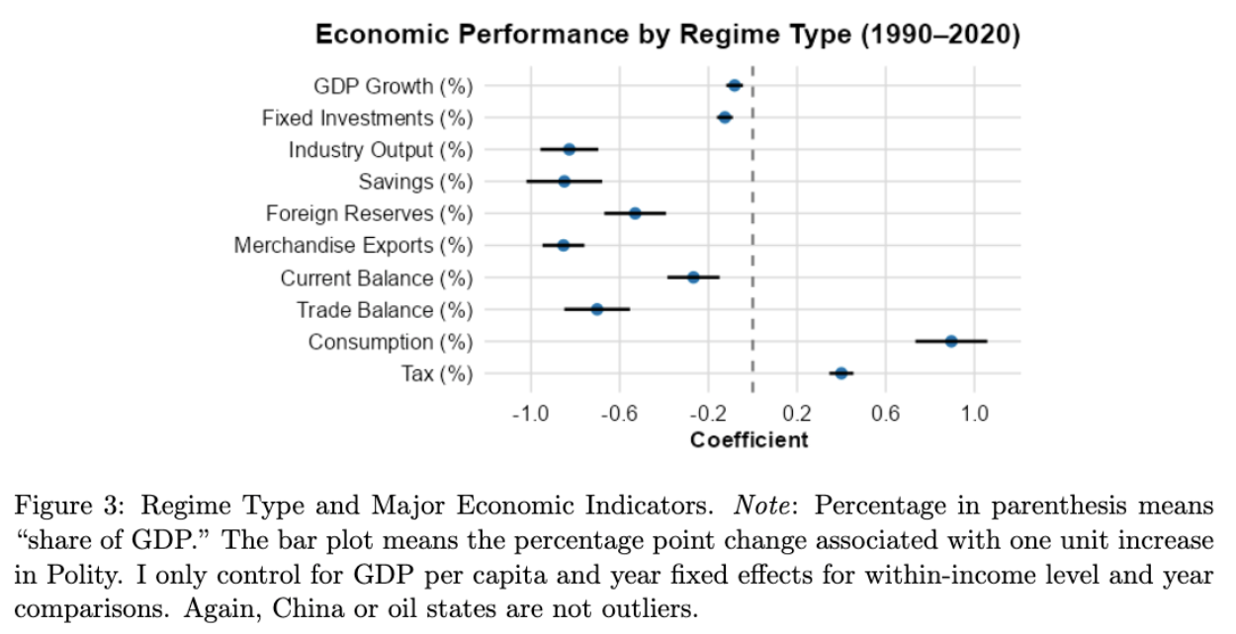

Autocratic Rise: Economic

Slide 5
”… With the spectacular economic growth under nondemocracy in China, the eclipse of the Arab Spring, and the recent rise of populist politics in Europe and the United States, the view that democratic institutions are at best irrelevant and at worst a hindrance for economic growth has become increasingly popular in both academia and policy discourse …
–– Acemoglu et al. 2019, JPE
➔ Pessimistic & why?

Slide 6

What Does Literature Say?
Growth: mixed
(Przeworski et al. 2000; Barro 1996)
Exports: democracy is better
(Eichengreen and Leblang 2007; Levchenko 2007; Yu 2010)
Institutional theory: inclusiveness is better
(Acemoglu et al. 2001; Acemoglu et al. 2012; North 1990)
Mostly use pre-2000 data
Primarily on internal mechanisms
Ignores contextual transformation: post-1990 globalization
Notes:
But nearly end of 1980, autocracies lost out in computerization.

Slide 7
Historical Pict.: Contextual Transformation
Post-1990:
“Hyper-globalization”: trade, finance, GVC … (Baldwin 2016; Rodrik 2012)
Market-oriented, outward-looking reforms
Western engagement (e.g., WTO/IMF): credibility, market access, capital, technology … (Arias et al. 2018; Baccini and Urpelainen 2015; Baldwin 2016; Hafner-Burton and Schneider 2019).
Pre-1990 (Cold War):
Limited econ exchange, regional blocs
Many dev nations closed/inward-looking (e.g., ISI), “trade skepticism” (Sachs and Warner 1995)
Stagnation/crisis in 1980s-90s
➔
Critical for autocracy: weak internal demand & credibility
Notes:
Fundamental problems for aut even with smart leaders: weak demand, low credibility if no trade and inst reform.

Slide 8
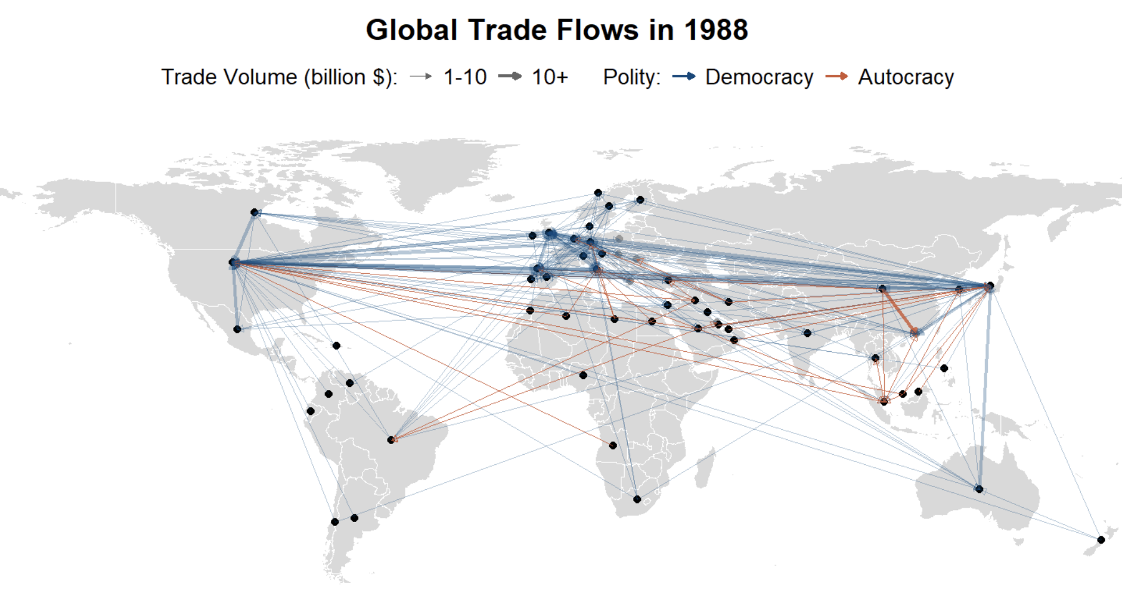
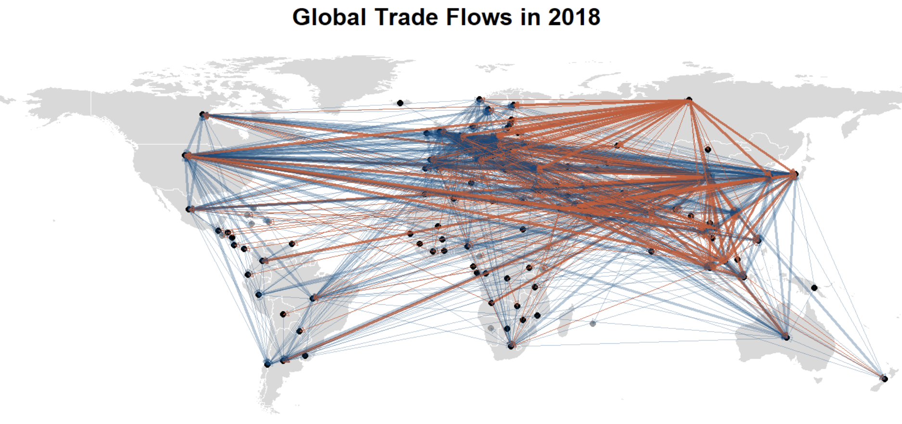
Example: International Trade

Slide 9
The Argument/Theory
Driven by a special form of autocratic regime types: “engaged reformers”
1) economically reformed: credibility, incentive of actors
2) economically engaged: market access, resources, information, credibility
Stronger inst./non-inst. abilities to compete for external demand than its democratic “counterfactual”
Though weaker internal demand (due to non-inclusive poli. Inst.) –– fundamental issue abs. globalization
scope condition
Notes:
Globalization met two conditions, and allows demand competition,

Slide 10
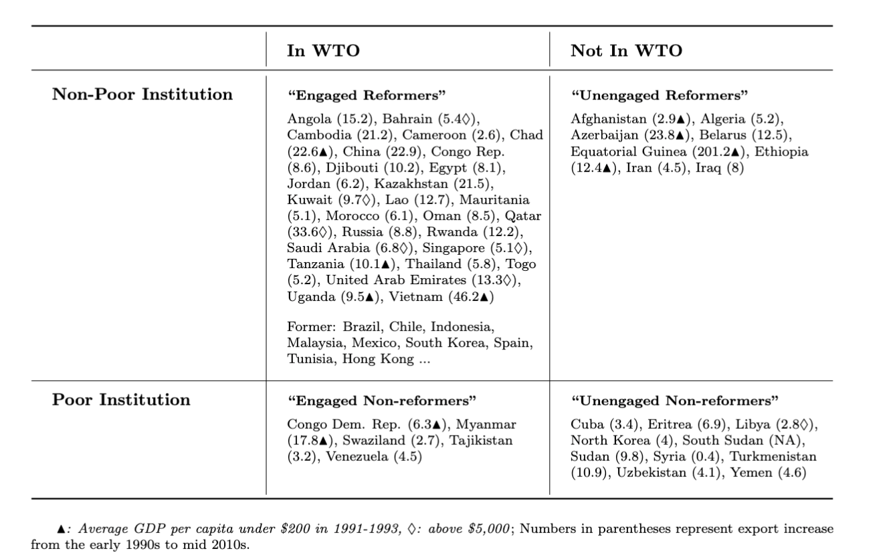
“Engaged Reformer”: Face Validation
Historically pre-1990…
*Dozens of stars in East/Southeast Asia
*Other cases (to varied degrees):
… Pinochet’s Chile (1980/90s); Franco’s Spain (1959–1974); Junta’s Brazil (1968-1973); Salazar’s Portugal (1960s); PRI’s Mexico (1980/90s); Fujimori’s Peru (1993–1999); Trujillo’s Dominican Republic (1950/60s); Argentina (1966-83); Botswana (1966–1980)…

Slide 11
Unpacking Theory: Globalized Economy (vs. Pre-1990)
Development logic: shifts outward for market, capital, technology, and information
(H-O/R-V; Krugman 1979; Grossman and Helpman 1991; Melitz 2003; Antras 2015; Atkeson & Burstein 2010; Burstein & Melitz 2013)
Old game (e.g., ISI) gone; have to adopt certain level of ”Washington Consensus” ➔ help how to improve exports (e.g., devaluation)
Demand competition: creates ample space for self-interested intervention
(Garret 2000; “cost advantage” see Eaton & Kortum 2002; Arkolakis et al. 2018; Melitz 2003; Costinot et al. 2013; Epifani & Gancia 2017)
Externalize domestic distortion: e.g., beggar-thy-neighbor
Scope condition: meets (for many) reform and engagement
Notes:
the global trade system, combined with floating exchange rates and freer capital flows

Slide 12
“Autocratic Advantages”: Mechanisms
Reform-and-open scenario: inst. disadvantage ➔ advantage (passive/active)
Centralized power: swift response, economic resilience, consistent planning, state support (Clegg et al. 2018; Haggard 1990; Kim 2018; Wade 1990; Wu 2016)
Weak inst. constraints (ex ante): weak opposition, large w/s, resource allocation, MNCs attraction, policy flexibility (Allen & Ge working; Brune et al. 2001; Steinberg and Malhotra 2014; Lipscy 2018; Putnam 1995)
Weak accountability (ex post): limited redistribution, labor/env/corporatist group suppression, enforced austerity/saving (Quinn and Woolley 2001; Sah 1991; Zakaria 1997; Rodrik 1999; Manger and Sattler 2015; Feierherd 2024; Krueger 1974)
Other: resource endowment, consumption-discouraging norms
Example: wage suppression or low welfare weakens domestic consumption, unless the resulted cost competitiveness captures more external markets, industrial share, and MNC favors.
Notes:
Active and passive

Slide 13
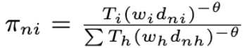
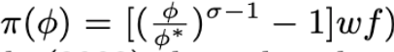
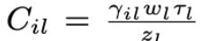
e.g. Models
Eaton & Kortum 2002:
Melitz 2003:
Arkolakis et al. 2018:
*see paper for a formal model of engaged reformer and trade facilitation:
regime x selectorate: leader survival, institution, trade policy
Notes:
-These measures, partly because they work, were used to manage resistance, enforce compliance, and stabilize systems that prioritize market logic
-some regime characteristics that may otherwise be disadvantages in a relatively closed economy can indeed become advantageous, since the goal is about competing for external demand
-In contrast, many Latin American democracies even have stricter labor regulations than OECD countries (Feierherd 2024)

Slide 14
Applying to Globalization
Many transformations in globalization: Trade, finance, migration, governance, security, environment, culture, norms …
Focus on two trade-enhancing ones: (North 1990; Haggard 1990)
1) trade integration
2) domestic reform

Slide 15
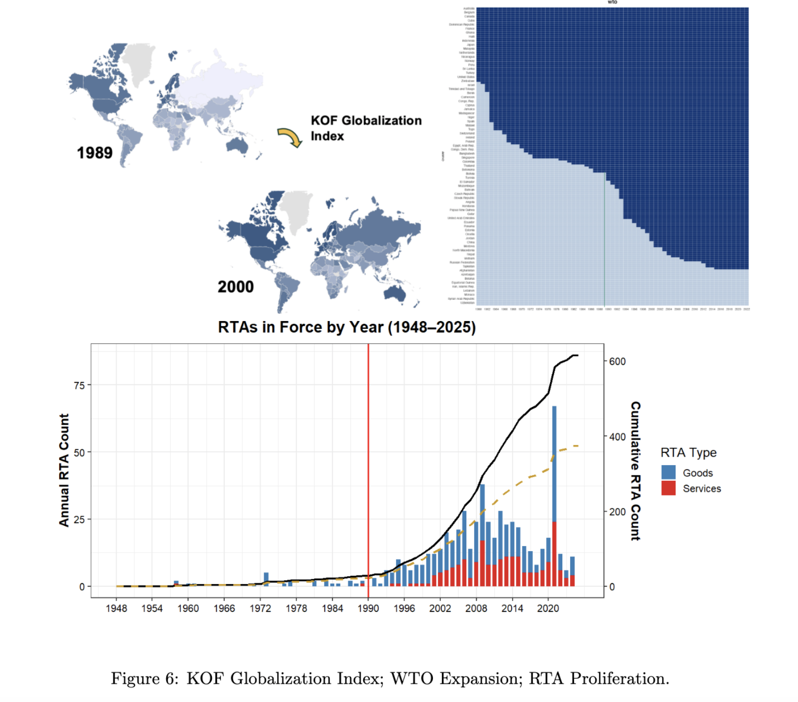
Trade Integration
WTO – “the most heralded commercial agreement in history” (Bagwell and Staiger 2002; Goldstein et al. 2007)
Other: MFN/PTA, RTA
IOs enhance credibility
“by 2000, most post-communist countries reoriented trade to Western markets for growth” (Aslund 2012)

Slide 16
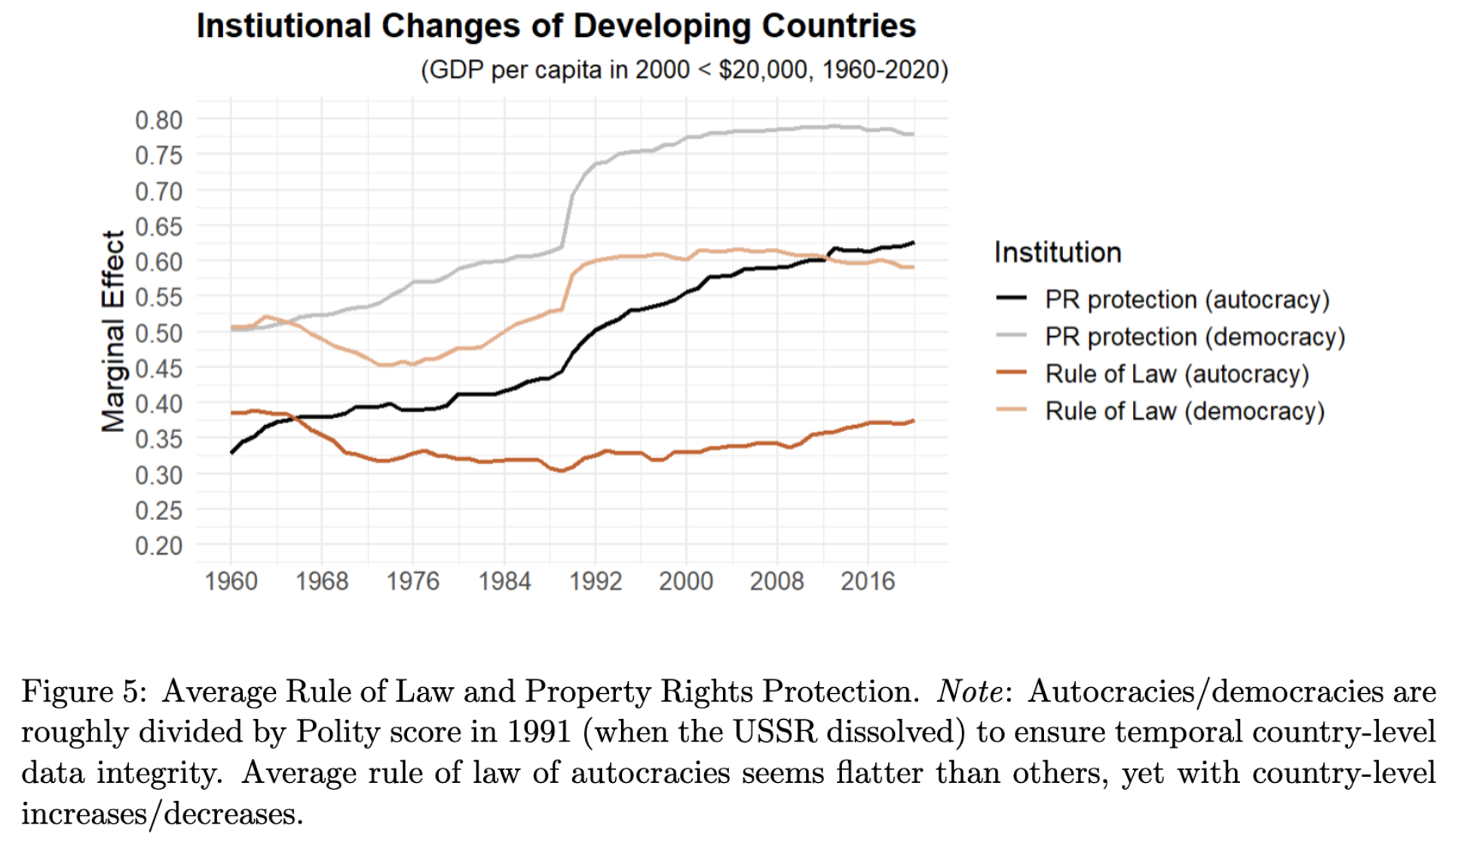
Institutional Reform
Both autocracies and democracies
Market-oriented & institutional reform
PR protection and RoL most important (Acemoglu et al. 2005)
E.g. Turkmenistan vs. Azerbaijan

Slide 17
Empirics
General Hypothesis:
“engaged reformers” benefit the most from & perform the best in globalized economy.

Slide 18
DV (regarding External Demand)
Exports
Gain in income/productivity/innovation (Bernard et al. 2018; Helpman and Krugman 1985)
r = 0.74 (avg. growth rate, 1992-2015)
External Balance:
Structural/development issues; demand redistribution (Blanchard and Milesi-Ferretti 2009; Obstfeld and Rogoff 2009; Chinn and Ito 2021)
r = 0.65 (avg. growth rate)
Successful stories: East Asia, Core Europe, Gulf states
17 of 20 highest R&D expenditure countries
*trade has spill-over effects (e.g., China shock, dependency)

Slide 19
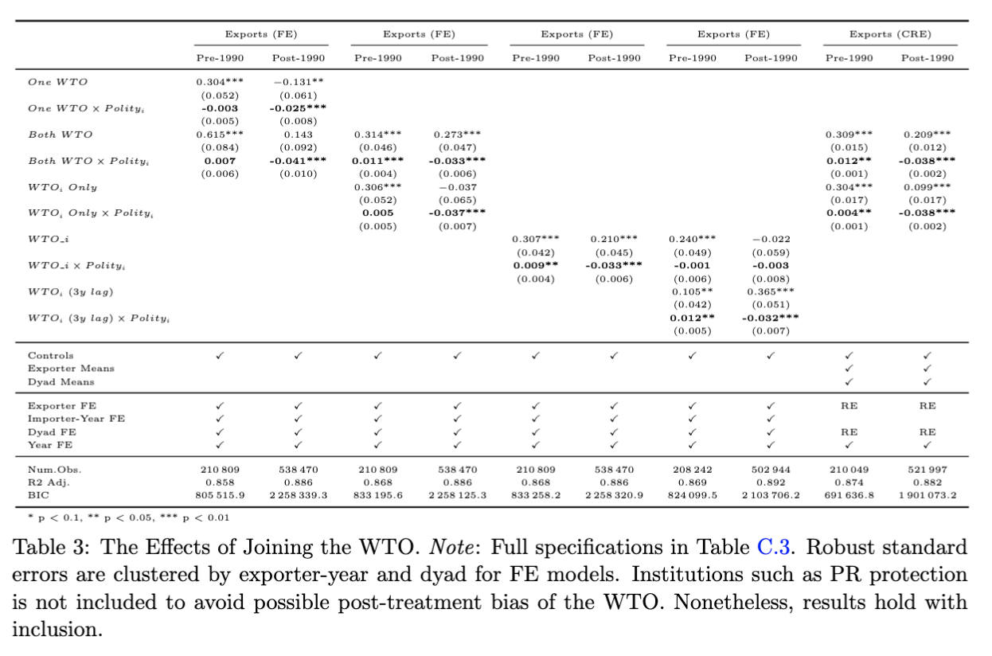
Result 1.1: WTO Accession
Gravity model:
(Anderson & van Wincoop 2003; Carnegie 2014; Goldstein et al. 2007; Rose 2004; Yu 2010 …)
“one of the most robust empirical findings” (Chaney 2018)
CRE model:
(correlated random-effects)
Polity
-5: 45.5%
5: 4.6%
-10: 71%
10: -11.4%

Slide 20
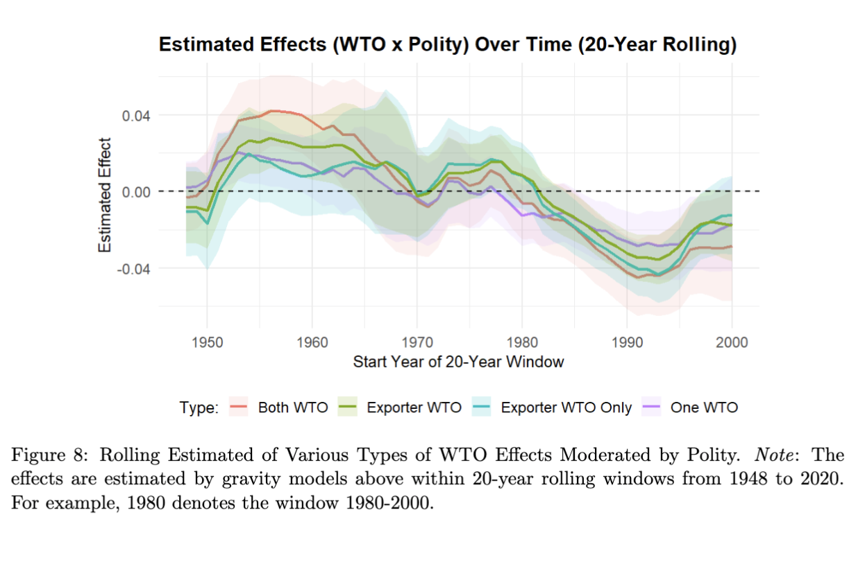
Result 1.1: WTO Accession

Slide 21
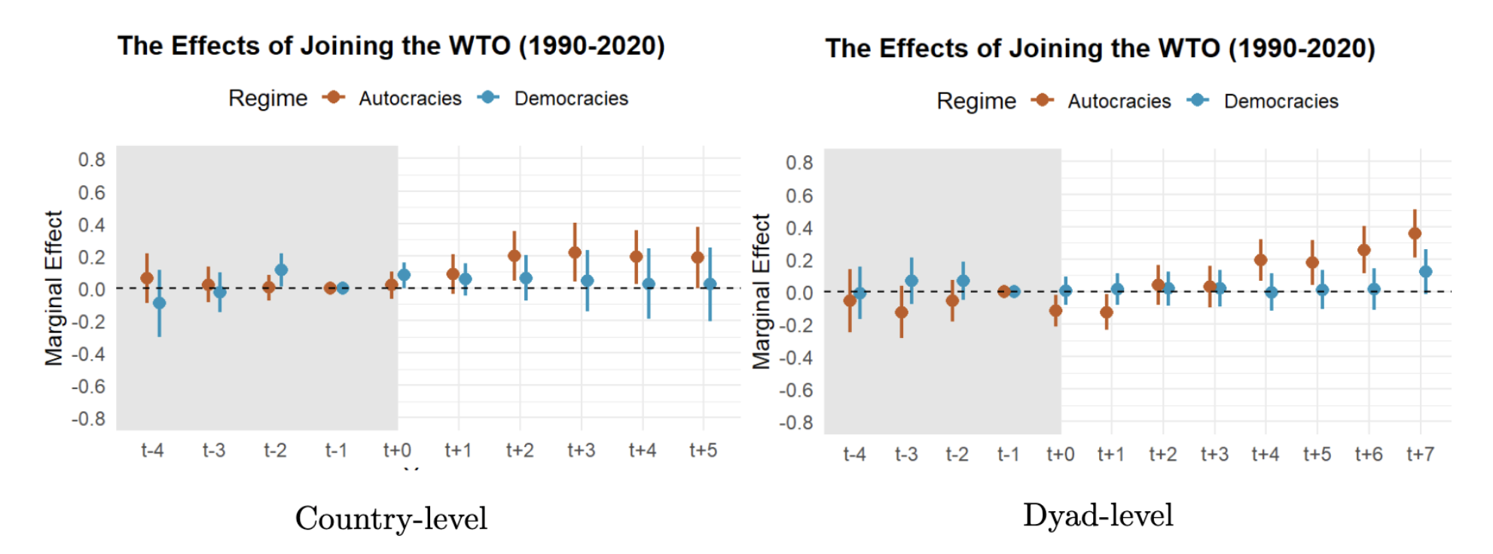
Result 1.1: WTO Accession
Sensitivity Analysis: Population (x250), GDP (x1000), Polity (x12)
DiD w/ staggered CBPS matching:

Slide 22
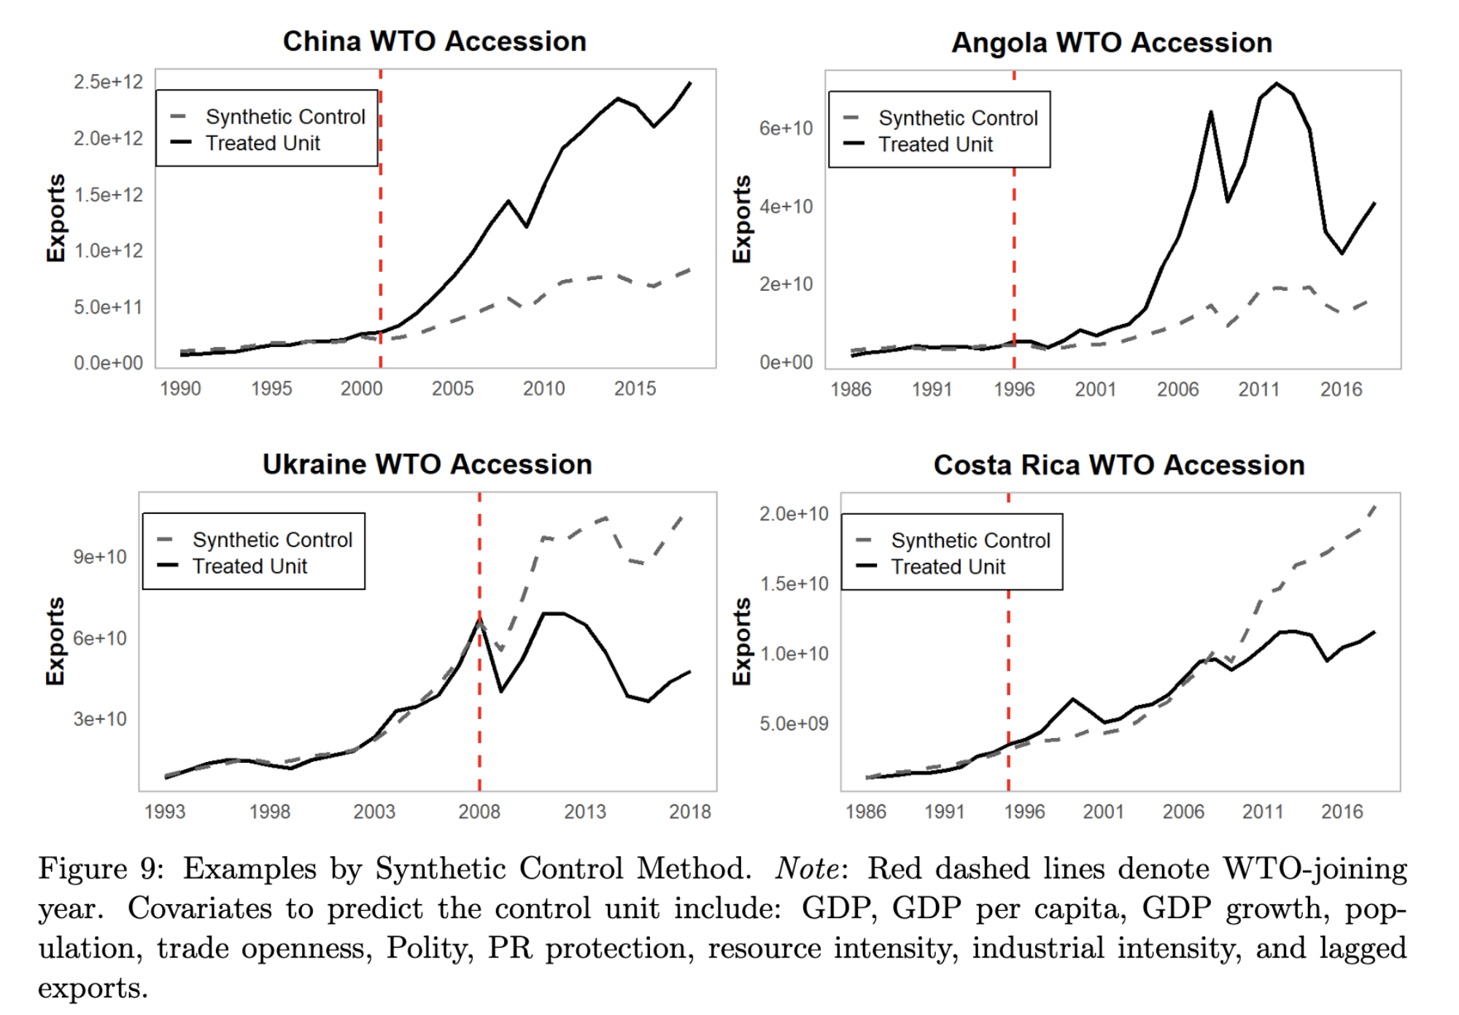
Result 1.1: WTO Accession
Examples, SCM:

Slide 23
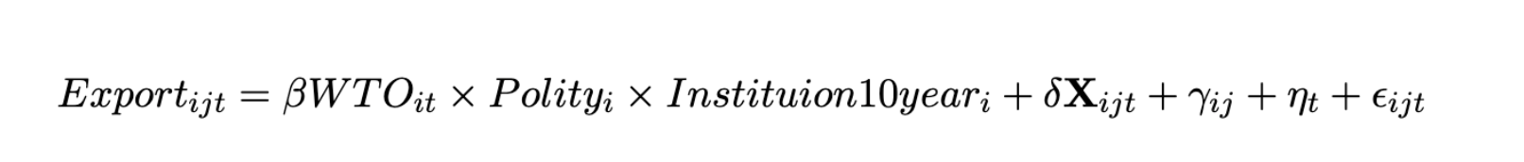
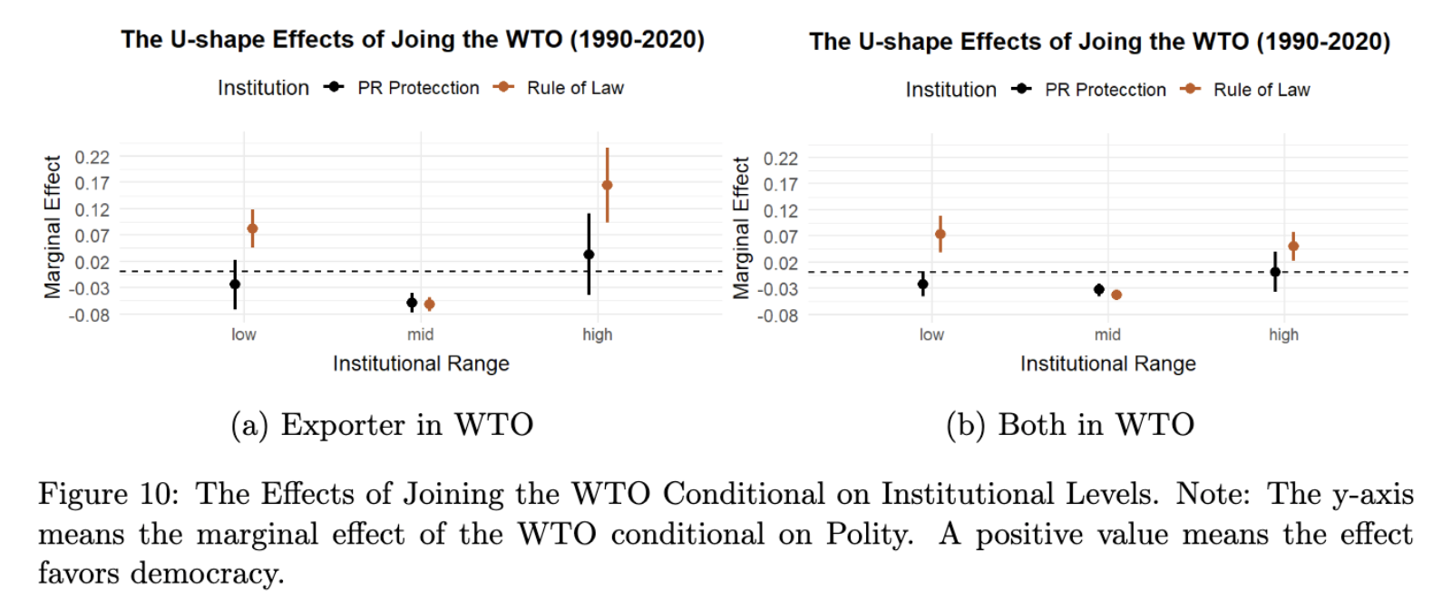
Result 1.2: Vary by Inst. (U-shape)
*inst. range dummy: lowest/highest 20th quantiles in 2000, w/ a ±10 ppt. variation.

Slide 24
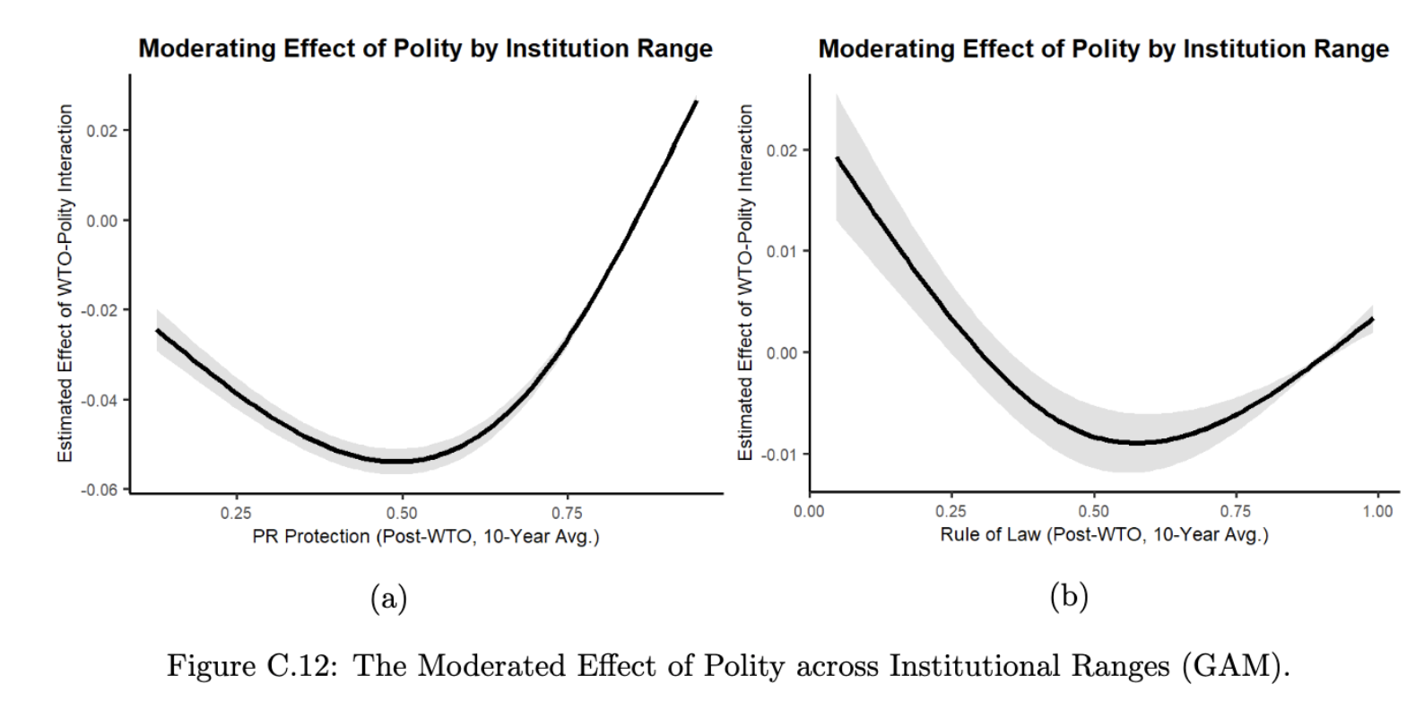
Result 1.2: by Inst.
Semi-parametric estimation (Generalized Additive Model)

Slide 25
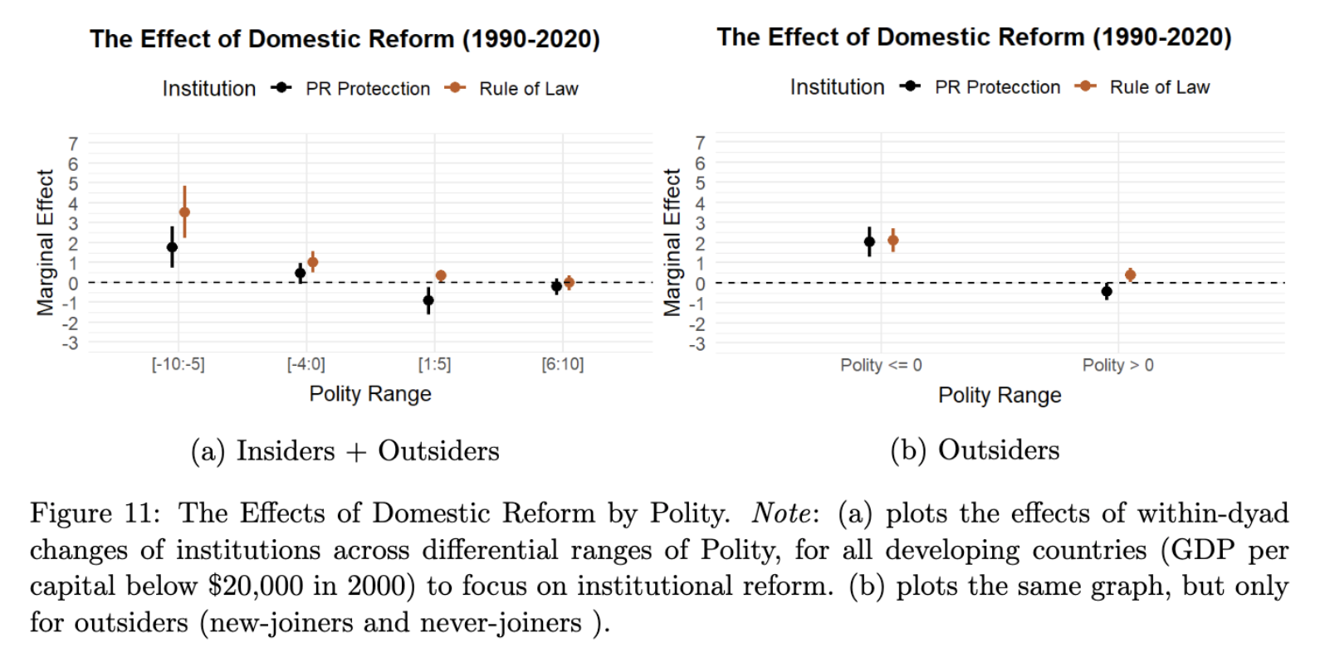
Result 2.1: Inst. Reform

Slide 26
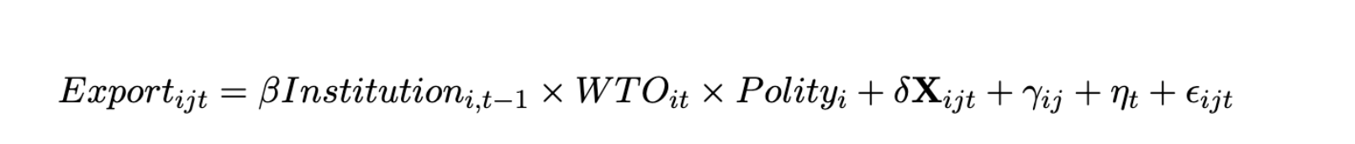
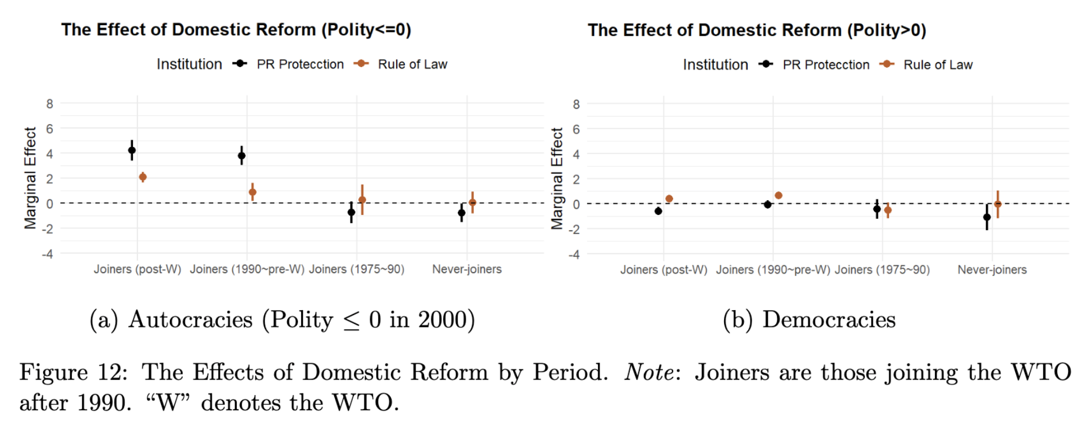
Result 2.2: by WTO-related Period
Notes:
Although it’s hard to know the counterfactual of reform effect of when joiners are not in WTO, we can still get some effect

Slide 27
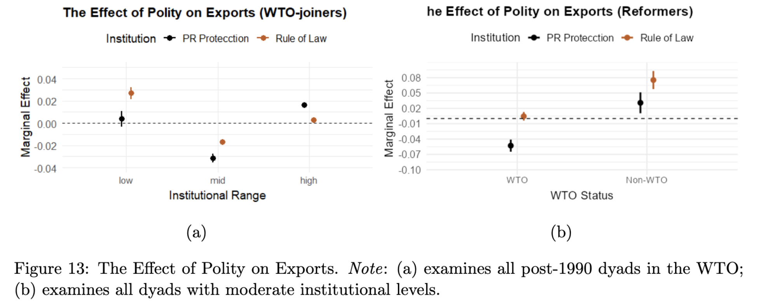
Result 3: Absolute Exports

Slide 28
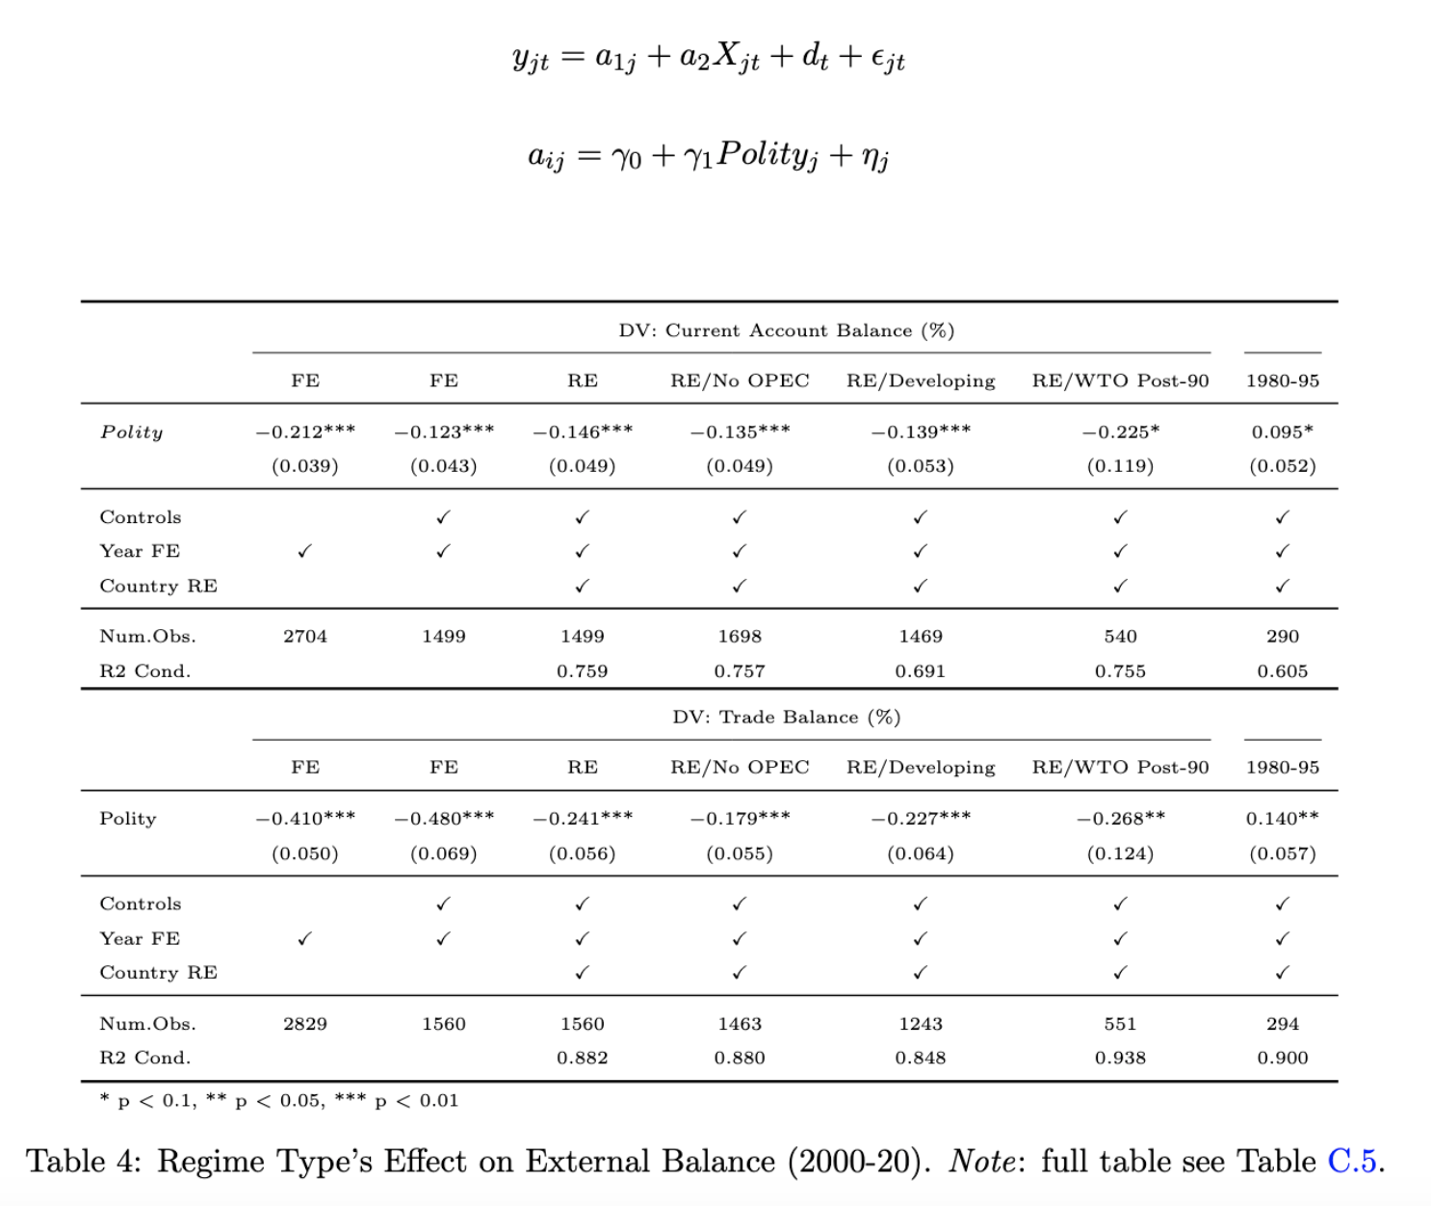
Result 4: External Balance
Hierarchical Model
(Chinn and Ito 2021; Manger and Sattler 2020)

Slide 29
Mechanisms

Slide 30
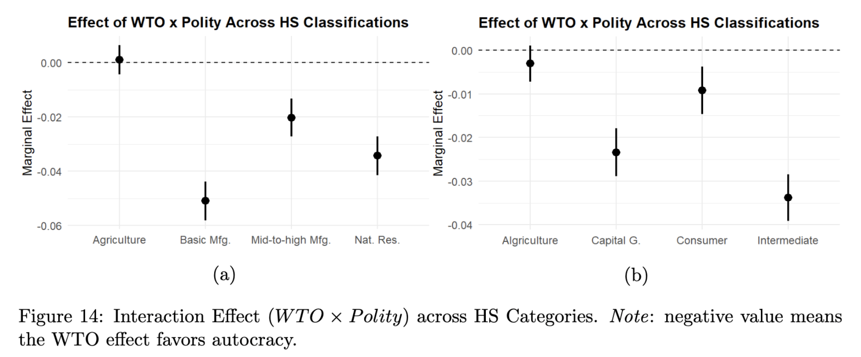
Mechanisms: Sectoral-level Evidence

Slide 31
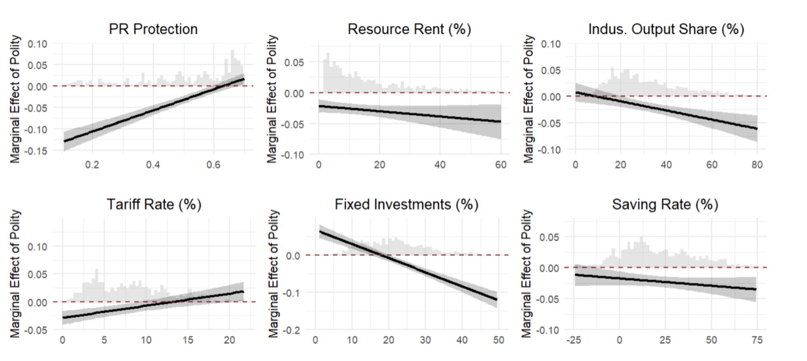
Mechanisms: Mediating Tests

Slide 32
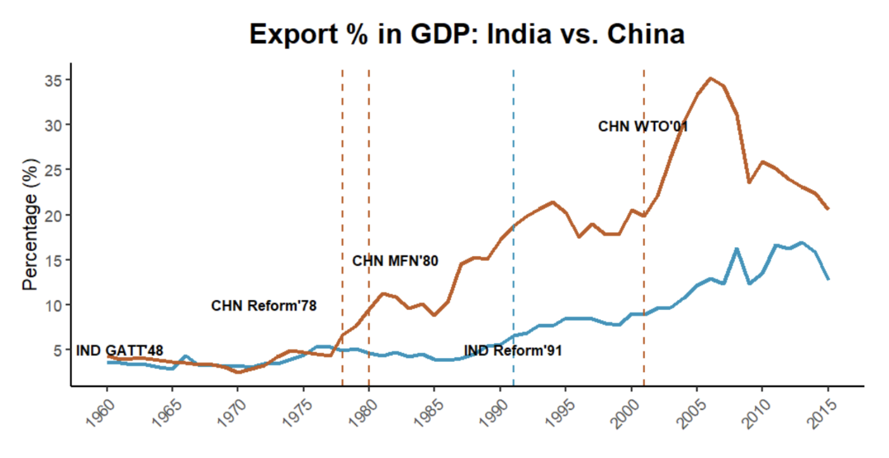
Qualitative Case
“...China’s political regime allows a gradualist approach which blended state control with market, and long-term planning employing economic zones and industrial policies (Lin et al. 2003), as well as the suppression of wages…”
“…India’s democratic system, though more inclusive, must navigate coalition politics, public dissent, and legal constraints, resulting in slow decision-making and low mercantilist policies (Groth 2006)…”
Qualitatively similar before 1980s: demographics, economy, trade-related geo …
Similar trajectories for decades until China reformed and engaged.

Slide 33
Possible Questions/Competing Theories
Selection bias?
Catch-up story?
Importing credibility?
State capacity?
Democracy-autocracy trade before 1990?
Back-and-forth in GVC?
Commodity boom?
MFN status?
FDI?

Slide 34
Conclusion
A theory of unexpected autocratic rise (conceptualizing engaged reformer) ⇒ external/contextual factor
A system-level examination of neoliberal globalization
No pessimism: free trade/globalization not inherently wrong (if meeting assumptions)
Potential future work:
MNCs’ investing preferences facing engaged reformer vs. developing democracy.
e.g., Japanese MNCs in Vietnam & the Philippines
Thank you!
gyean@fas.harvard.edu

